Slide 1
Building and Construction Industry Security of Payment Act 1999 (NSW)
28 February 2024

Slide 2
Agenda
Introduction
What is SOPA?
Why use SOPA?
Who can use SOPA?
When is it used?
How does SOPA work?
What to do if aggrieved?

Slide 3
A. Introduction
Legal services for the construction industry
Jock Hamilton, Helay Zarmati, Mili Curic, Peter Sarlos, Allegra Flemming, Hugh Robinson, Harrison Kerr
Front-end, project delivery support, back-end dispute resolution
Notes:
Talk about when the firm was started: 2021.
Who this presentation is for?

Slide 4
B. What is SOPA?
x4 words
Referral of certain disputes to third party adjudicators to make interim determinations in respect of those disputes
Rapid fire determinations, to encourage cash-flow
Adjudicators are not necessarily lawyers; often quantity surveyors, architects, project managers
Adjudicators are allowed to make errors (except jurisdictional errors!) The determinations are interim only, the legislature wants to empower adjudicators to make non-jurisdictional errors
Notes:
Legislation, different in each state and territory, designed to encourage cash flow to subcontractors.
Claimant to use

Slide 5
C. Why use SOPA?
Timing
Cash flow
Informality

Slide 6
D. Who?
Developer / Principal
Principal Contractor
Subcontractor
Subcontractor
Consultants
Suppliers

Slide 7
Project timeline
E. When?
1. Procurement
2. Delivery
3. Commercial
Notes:
By subcontractors and head contractors when the client is not paying!
Usually at the back-end of a project
During the project, if the developer appears to be in financial difficulty
Usually takes about 45 days from go-to-whoa
Allocating risks – to the principal or contractor. If the contractor is taking the risk, what to do: insure or price it.

Slide 9
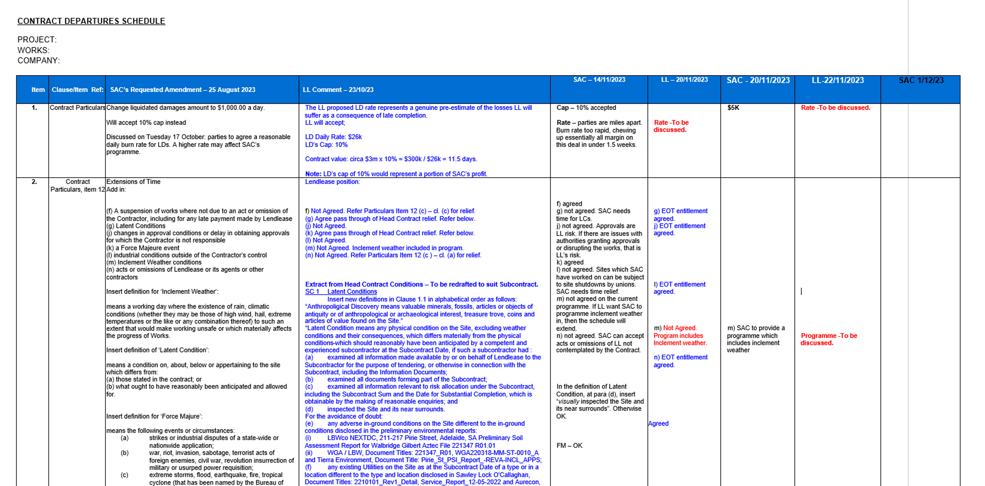

Slide 10
F. How does SOPA work?
Building and Construction Security of Payment Act 1999 (NSW):
Payment Claim – Claimant
Payment Schedule – Respondent
Adjudication Application – Claimant
Adjudication Response – Respondent
Determination – Adjudicator
Enforcement – Claimant

Slide 11
F1. Payment claims
Statutory requirements
Identify the construction work
Be served on the Respondent
Be served within time
Practical suggestions
Excel spreadsheet identifying:
Base scope works
Variation works
Basis of entitlement - by reference to the risk profile under the Contract
Reference to supporting documents
For variations, each claim should have a separate variation claim previously submitted
Notes:
Entitlement to monthly payment claims under the Act. So Contractor can issue a payment claim once per month under the Act.

Slide 12
F1. Payment claims cont’d

Slide 13
F1. Payment claims cont’d
Notes:
Note the payment claim is not an invoice but it can be. Ie sophisticated contractors do not invoice.

Slide 14
F2. Payment Schedules
Statutory requirements – s 14 of the Act (10 BDs)
10 BDs
Identify the payment claim
Identify the amount of the proposed payment
Indicate reasons for not providing payment
Practical suggestions
Do the work for an Adjudication Response at this stage
Focus on the high value claims
Put in more reasons not less (noting that reasons subsequently raised in an AR cannot be relied on)

Slide 15
F2. If no payment schedule?
S 17(2) notice
Give a further opportunity to serve a payment schedule
Sue for a statutory debt
Pleading only the existence of the statutory debt and how that arose, no need for a broader pleading
Summary judgment application – after the defence has been filed
When to give the s 17(2) notice vs sue for a statutory debt?
Notes:
Note that only apply for a statutory debt at the end of the project, otherwise the head contractor will just reverse it in the next payment schedule.

Slide 16
F3. Adjudication Applications
What are they?
Submissions – note your audience
Evidence
Lay
Expert (programming / quantum)
Timeframes
10 BDs of the PS
How to structure the submissions?
Overview of the project
Overview of what the Claimant wants
Jurisdictional matters that the adjudicator needs to be satisfied with
Specific positions on the claims
References to any evidence (lay or expert)
Responsive positions to anticipated arguments raised by the Respondent (payment schedule will give an indication)
Position on the Adjudicator’s costs

Slide 17
F4. Adjudication Responses
Keep short
Key issues given tight timeframes
Jurisdictional points
Specific issues – key responses
Lay evidence
Expert evidence

Slide 18
F5. Adjudication Determinations
Seeking a site viewing
Adjudicators asking for more time? To grant or not
Unsolicited submissions
Beware rogue adjudicators
Multiple rounds of further submissions

Slide 19
F6. Enforcement
Obtain an Adjudication Certificate
File the Judgment Debt
Commence enforcement proceedings

Slide 20
G. What to do if aggrieved?
Jurisdictional issues?
Sue back
Negotiate

Slide 21
Q & A

Slide 22
Thank you Jock Hamilton – 0433 654 209
Helay Zarmati – 0434 873 530

